Slide 1
Point Spread Function (PSF)?

Slide 2
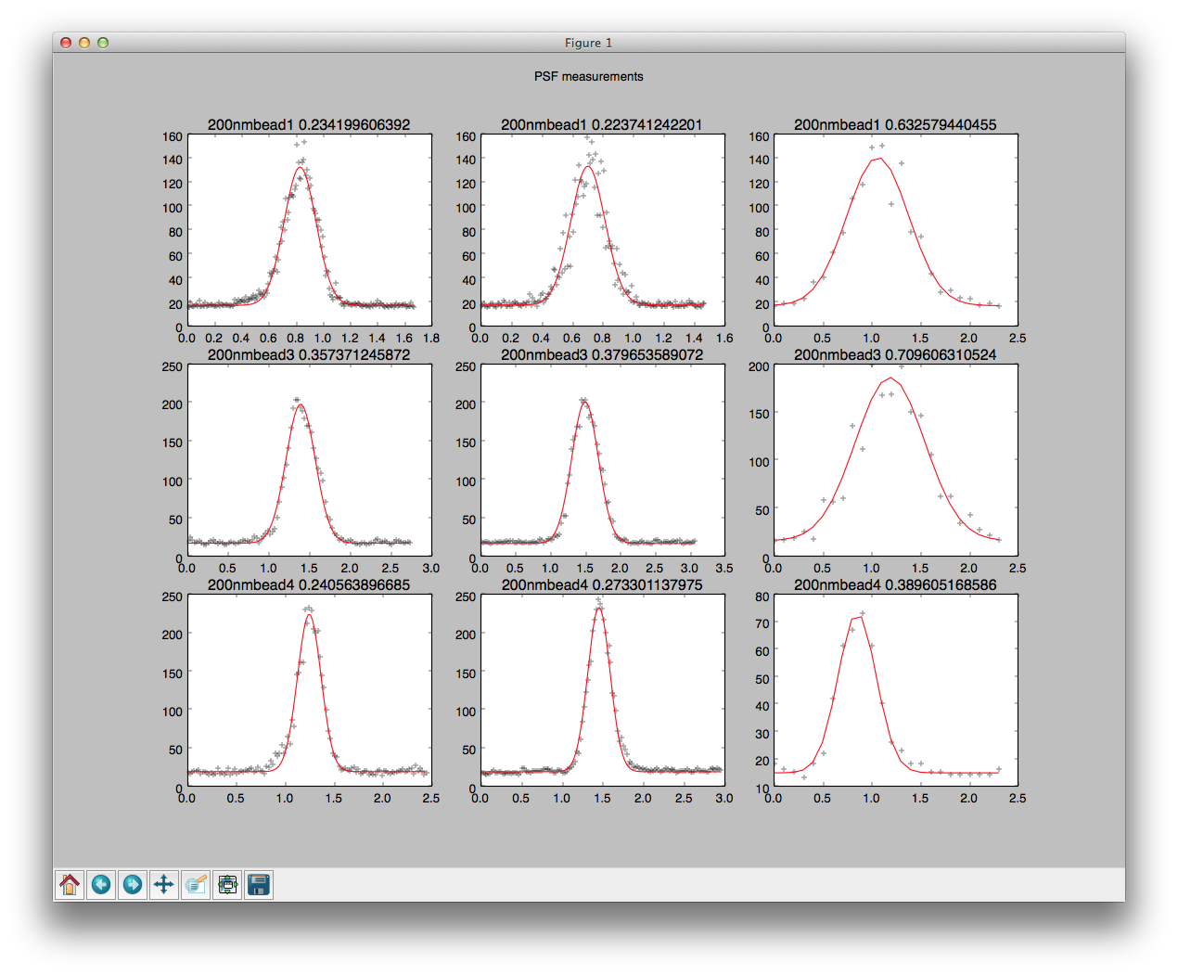
PSF measurements

Slide 3
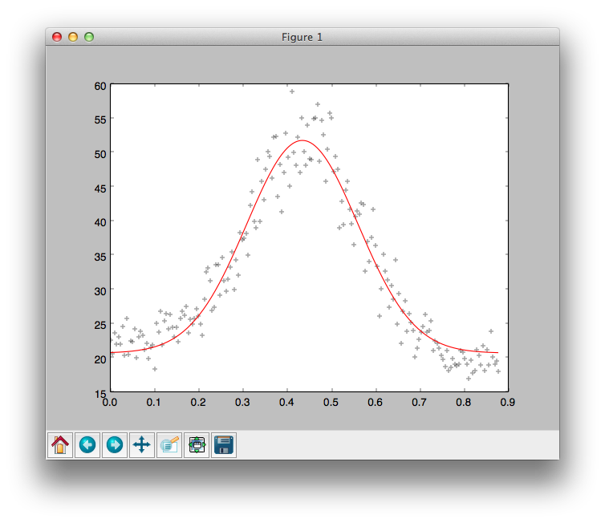
200nmbeadlsmpsfvalues x0
lmfit_psf.py
[[Variables]]
amp: 31.073220 +/- 0.599276 (1.93%) initial = 35.000000
offset: 20.719358 +/- 0.425463 (2.05%) initial = 20.000000
shift: 0.435099 +/- 0.002413 (0.55%) initial = 0.500000
w0: 0.251562 +/- 0.006815 (2.71%) initial = 0.250000
[[Correlations]] (unreported correlations are < 0.100)
C(offset, w0) = -0.706
C(amp, offset) = -0.508

Slide 4
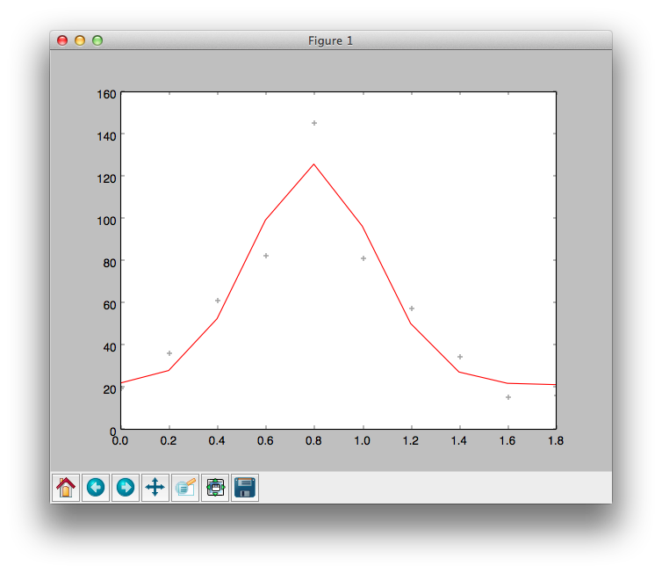
200nmbeadlsmpsfvalues z0
lmfit_psf2.py
[[Variables]]
amp: 104.617528 +/- 12.909328 (12.34%) initial = 35.000000
offset: 21.354756 +/- 7.866067 (36.84%) initial = 20.000000
shift: 0.794003 +/- 0.032577 (4.10%) initial = 0.500000
w0: 0.507180 +/- 0.084414 (16.64%) initial = 0.250000
[[Correlations]] (unreported correlations are < 0.100)
C(offset, w0) = -0.636
C(amp, offset) = -0.433
C(amp, w0) = -0.126

Slide 5
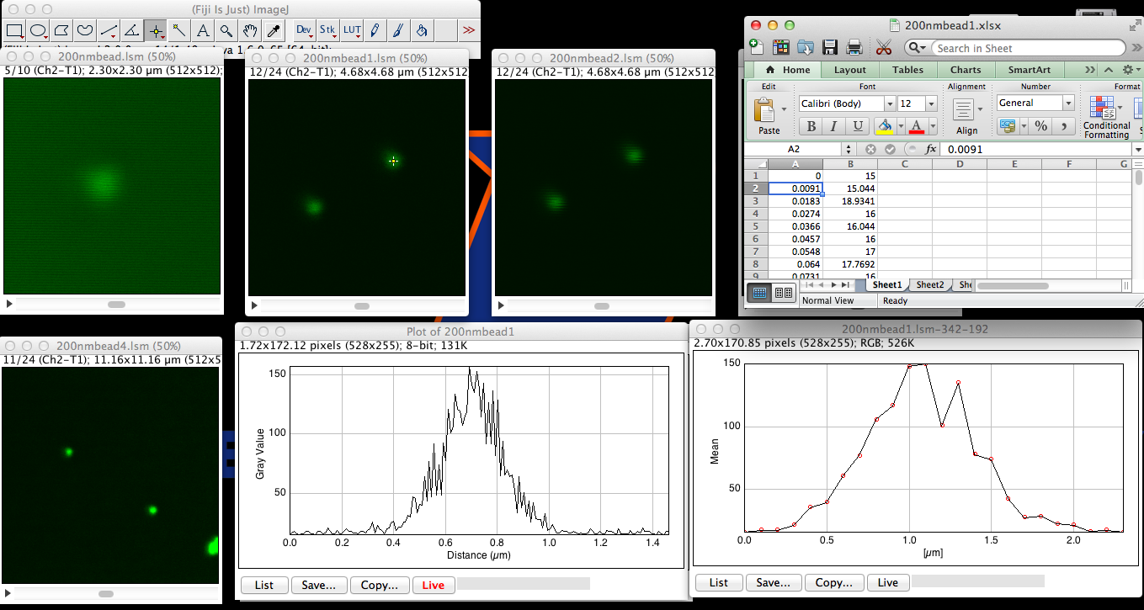
200nmbead1

Slide 6
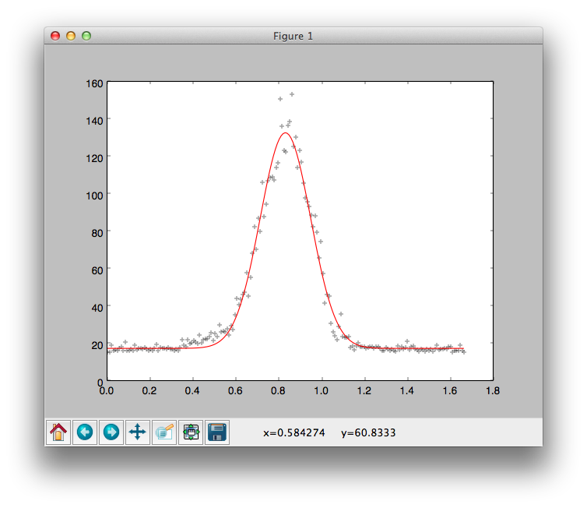
200nmbead1 x0
fit_psf.py
[[Variables]]
amp: 115.327219 +/- 1.323297 (1.15%) initial = 35.000000
offset: 17.447600 +/- 0.465364 (2.67%) initial = 20.000000
shift: 0.833237 +/- 0.001503 (0.18%) initial = 0.500000
w0: 0.234199 +/- 0.003289 (1.40%) initial = 0.250000
[[Correlations]] (unreported correlations are < 0.100)
C(amp, w0) = -0.410
C(offset, w0) = -0.406
C(amp, offset) = -0.249

Slide 7
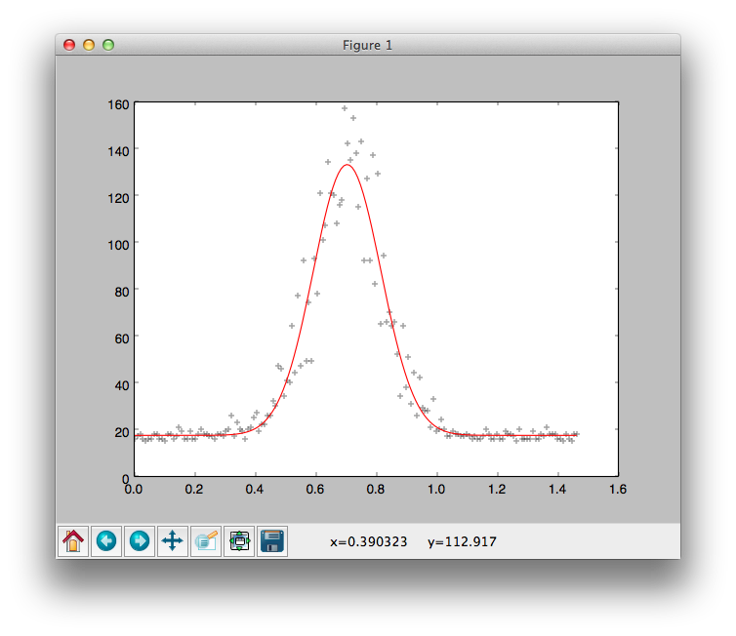
200nmbead1 y0
[[Variables]]
amp: 115.693294 +/- 2.523117 (2.18%) initial = 35.000000
offset: 17.775551 +/- 0.944900 (5.32%) initial = 20.000000
shift: 0.705217 +/- 0.002717 (0.39%) initial = 0.500000
w0: 0.223741 +/- 0.006016 (2.69%) initial = 0.250000
[[Correlations]] (unreported correlations are < 0.100)
C(offset, w0) = -0.430
C(amp, w0) = -0.389
C(amp, offset) = -0.265

Slide 8
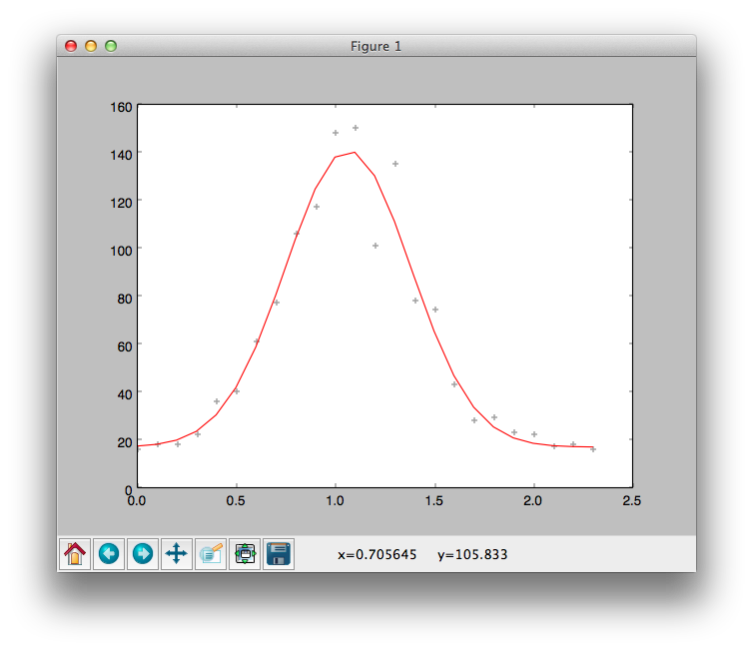
200nmbead1 z0
[[Variables]]
amp: 123.751526 +/- 5.793144 (4.68%) initial = 35.000000
offset: 17.170299 +/- 3.702968 (21.57%) initial = 20.000000
shift: 1.066692 +/- 0.015228 (1.43%) initial = 0.500000
w0: 0.632580 +/- 0.040439 (6.39%) initial = 0.250000
[[Correlations]] (unreported correlations are < 0.100)
C(offset, w0) = -0.658
C(amp, offset) = -0.455

Slide 9
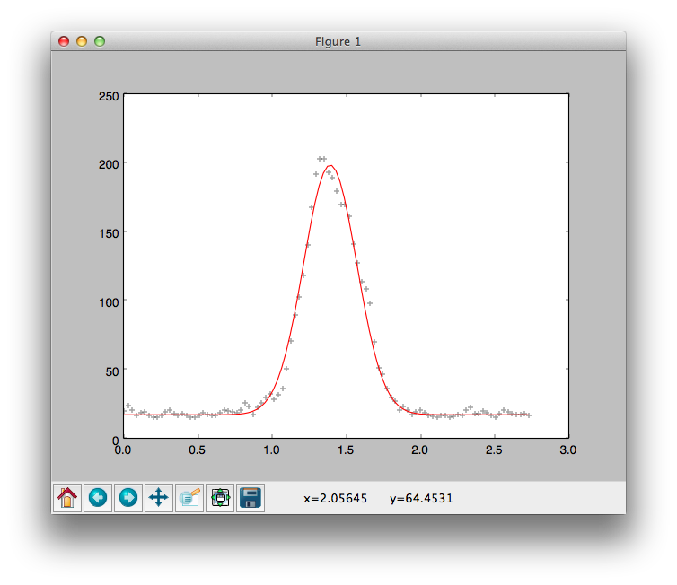
200nmbead3
fit_psf.py
[[Variables]]
amp: 181.246176 +/- 2.197658 (1.21%) initial = 35.000000
offset: 17.406558 +/- 0.730502 (4.20%) initial = 20.000000
shift: 1.395773 +/- 0.002432 (0.17%) initial = 0.500000
w0: 0.357372 +/- 0.005273 (1.48%) initial = 0.250000
[[Correlations]] (unreported correlations are < 0.100)
C(amp, w0) = -0.427
C(offset, w0) = -0.386
C(amp, offset) = -0.235

Slide 10
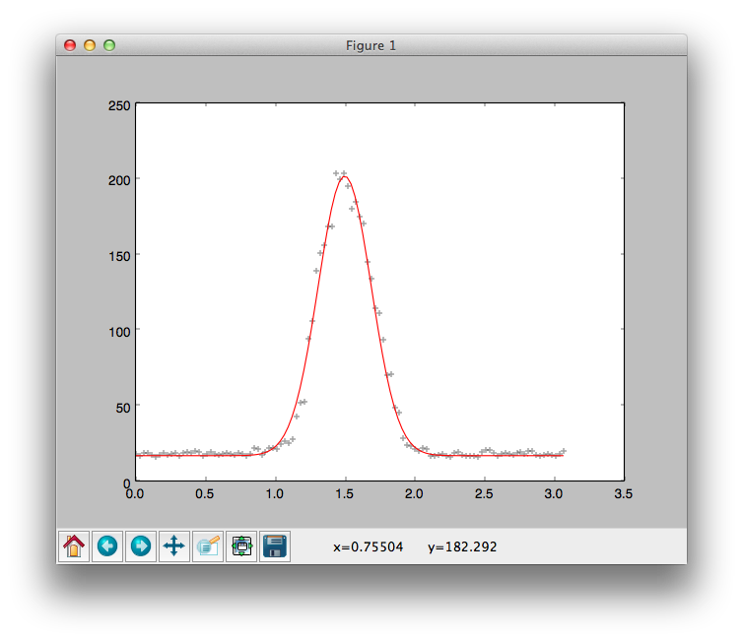
200nmbead3
[[Variables]]
amp: 184.840158 +/- 1.959717 (1.06%) initial = 35.000000
offset: 17.074021 +/- 0.626372 (3.67%) initial = 20.000000
shift: 1.501716 +/- 0.002264 (0.15%) initial = 1.500000
w0: 0.379654 +/- 0.004880 (1.29%) initial = 0.250000
[[Correlations]] (unreported correlations are < 0.100)
C(amp, w0) = -0.438
C(offset, w0) = -0.373
C(amp, offset) = -0.226

Slide 11
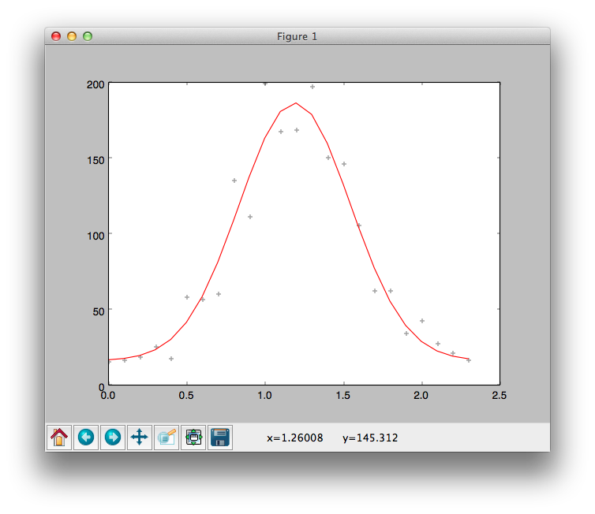
200nmbead3
[[Variables]]
amp: 170.370058 +/- 9.341175 (5.48%) initial = 35.000000
offset: 16.372455 +/- 6.958548 (42.50%) initial = 20.000000
shift: 1.192632 +/- 0.018967 (1.59%) initial = 1.500000
w0: 0.709606 +/- 0.055302 (7.79%) initial = 0.250000
[[Correlations]] (unreported correlations are < 0.100)
C(offset, w0) = -0.727
C(amp, offset) = -0.536

Slide 12
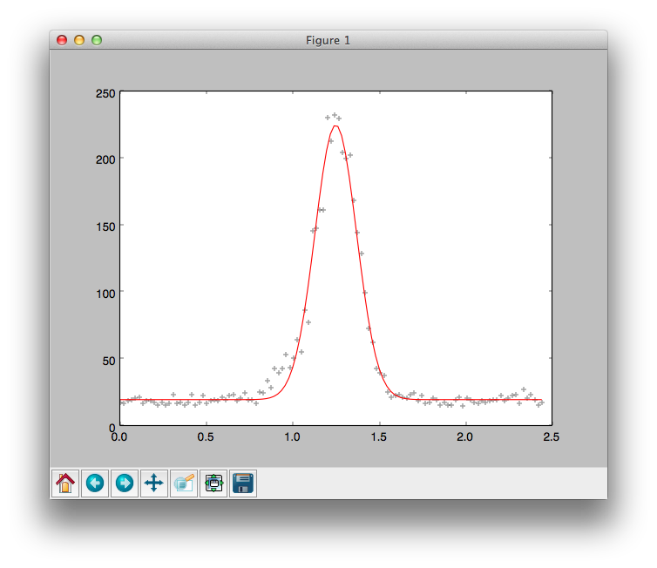
200nmbead4
fit_psf.py
[[Variables]]
amp: 205.278232 +/- 2.964974 (1.44%) initial = 35.000000
offset: 19.697933 +/- 0.812103 (4.12%) initial = 20.000000
shift: 1.251674 +/- 0.001968 (0.16%) initial = 1.000000
w0: 0.240564 +/- 0.004160 (1.73%) initial = 0.250000
[[Correlations]] (unreported correlations are < 0.100)
C(amp, w0) = -0.473
C(offset, w0) = -0.324
C(amp, offset) = -0.194

Slide 13
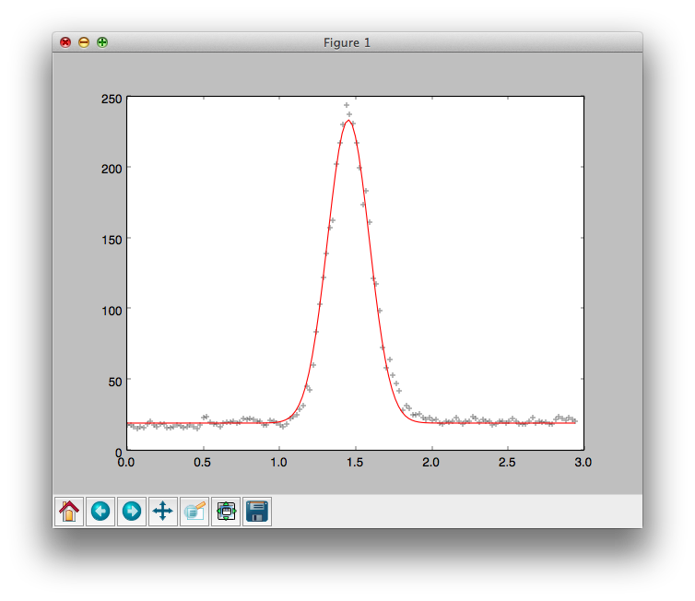
200nmbead4
[[Variables]]
amp: 214.158190 +/- 1.698129 (0.79%) initial = 35.000000
offset: 19.541638 +/- 0.448197 (2.29%) initial = 20.000000
shift: 1.457659 +/- 0.001229 (0.08%) initial = 1.000000
w0: 0.273301 +/- 0.002588 (0.95%) initial = 0.250000
[[Correlations]] (unreported correlations are < 0.100)
C(amp, w0) = -0.481
C(offset, w0) = -0.313
C(amp, offset) = -0.187

Slide 14
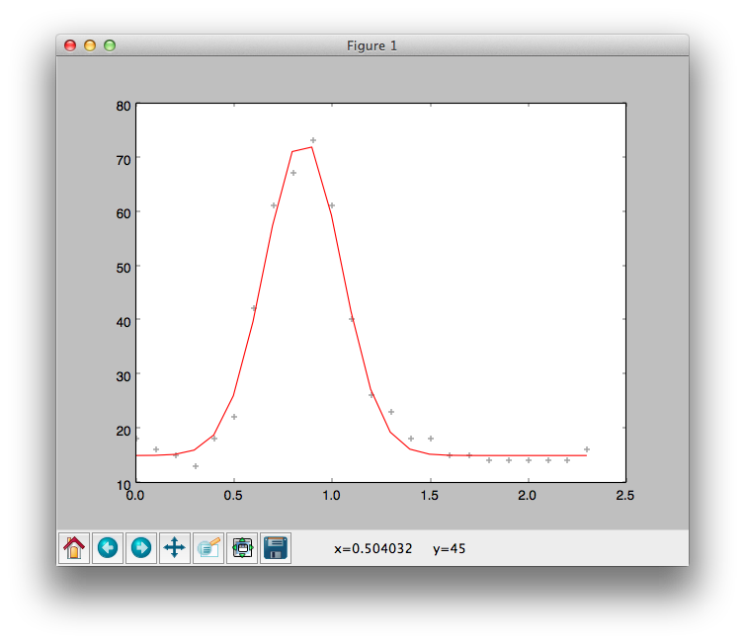
200nmbead4
[[Variables]]
amp: 58.423725 +/- 1.598752 (2.74%) initial = 35.000000
offset: 15.071612 +/- 0.630648 (4.18%) initial = 20.000000
shift: 0.855584 +/- 0.005911 (0.69%) initial = 1.000000
w0: 0.389605 +/- 0.013234 (3.40%) initial = 0.250000
[[Correlations]] (unreported correlations are < 0.100)
C(offset, w0) = -0.449
C(amp, w0) = -0.370
C(amp, offset) = -0.279

